Slide 1
Linac Components

Slide 2
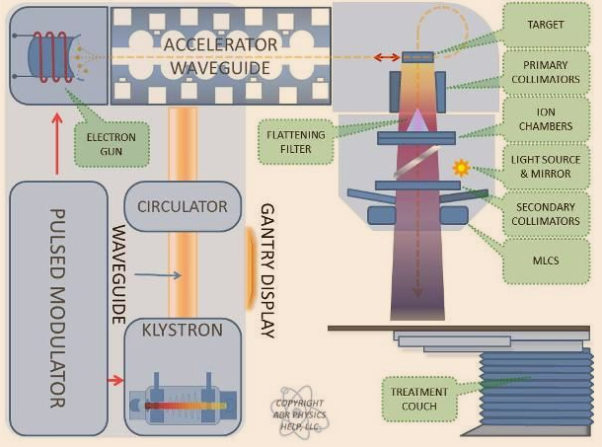
General Overview
We will trace path of power through the linac from wall → patient

Slide 3
Questions
Is linac beam continuous or pulsed?
Why?

Slide 4
Questions 2
How long are these pulses?
What is the time in between pulses?

Slide 5
Modulator
Large power supply
Supplies power to all components of the LINAC
Two main subsystems to Modulator:
Thyratron
Pulse Forming Network

Slide 6
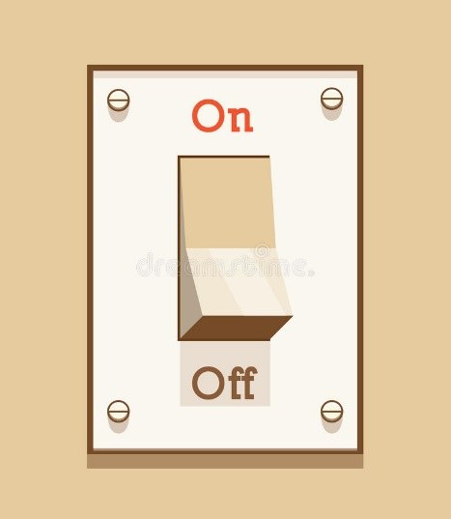
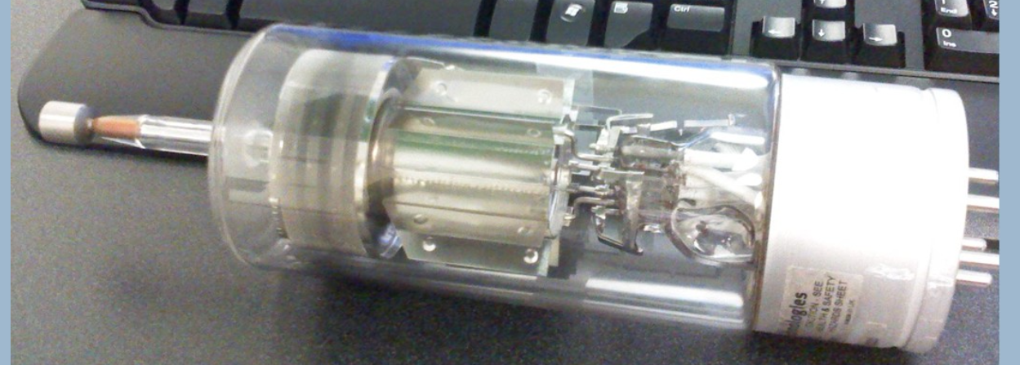
Modulator - Thyratron
Thyratron – High voltage on/off switch of the modulator
Power requirements of linac are too great for it to run power continuously
Capacitors are charged up and periodically discharged → controlled by thyratron
Thyratron filled with hydrogen gas with very low pressure to allow for high speed switching
Two separate thyratrons
De-Qing thyratron sits in front of the Pulse Forming Network and controls the charging of its circuits
Main thyratron sits after the PFN and controls the timing of pulses leaving the circuit
Main Thyratron

Slide 7
Question 3
If the thyratron in your linac breaks, what symptoms will the machine exhibit?
What QA is recommended after replacement of the thyratron?

Slide 8
Modulator
Pulse Forming Network
Receives power from the De-Qing thyratron
Steps up voltage from 10kV to ~100kV
Pulses are sent to the RF driver, klystron/magnetron, and electron gun

Slide 9
Questions
Is linac beam continuous or pulsed?
Why?

Slide 10
Answers
Is beam from LINAC continuous or pulsed?
Pulsed
Why?
Heat dissipation. Very high power needs in accelerating waveguide, so by using pulses, cooling requirement is manageable

Slide 11
Questions 2
How long are these pulses?
What is the time in between pulses?

Slide 12
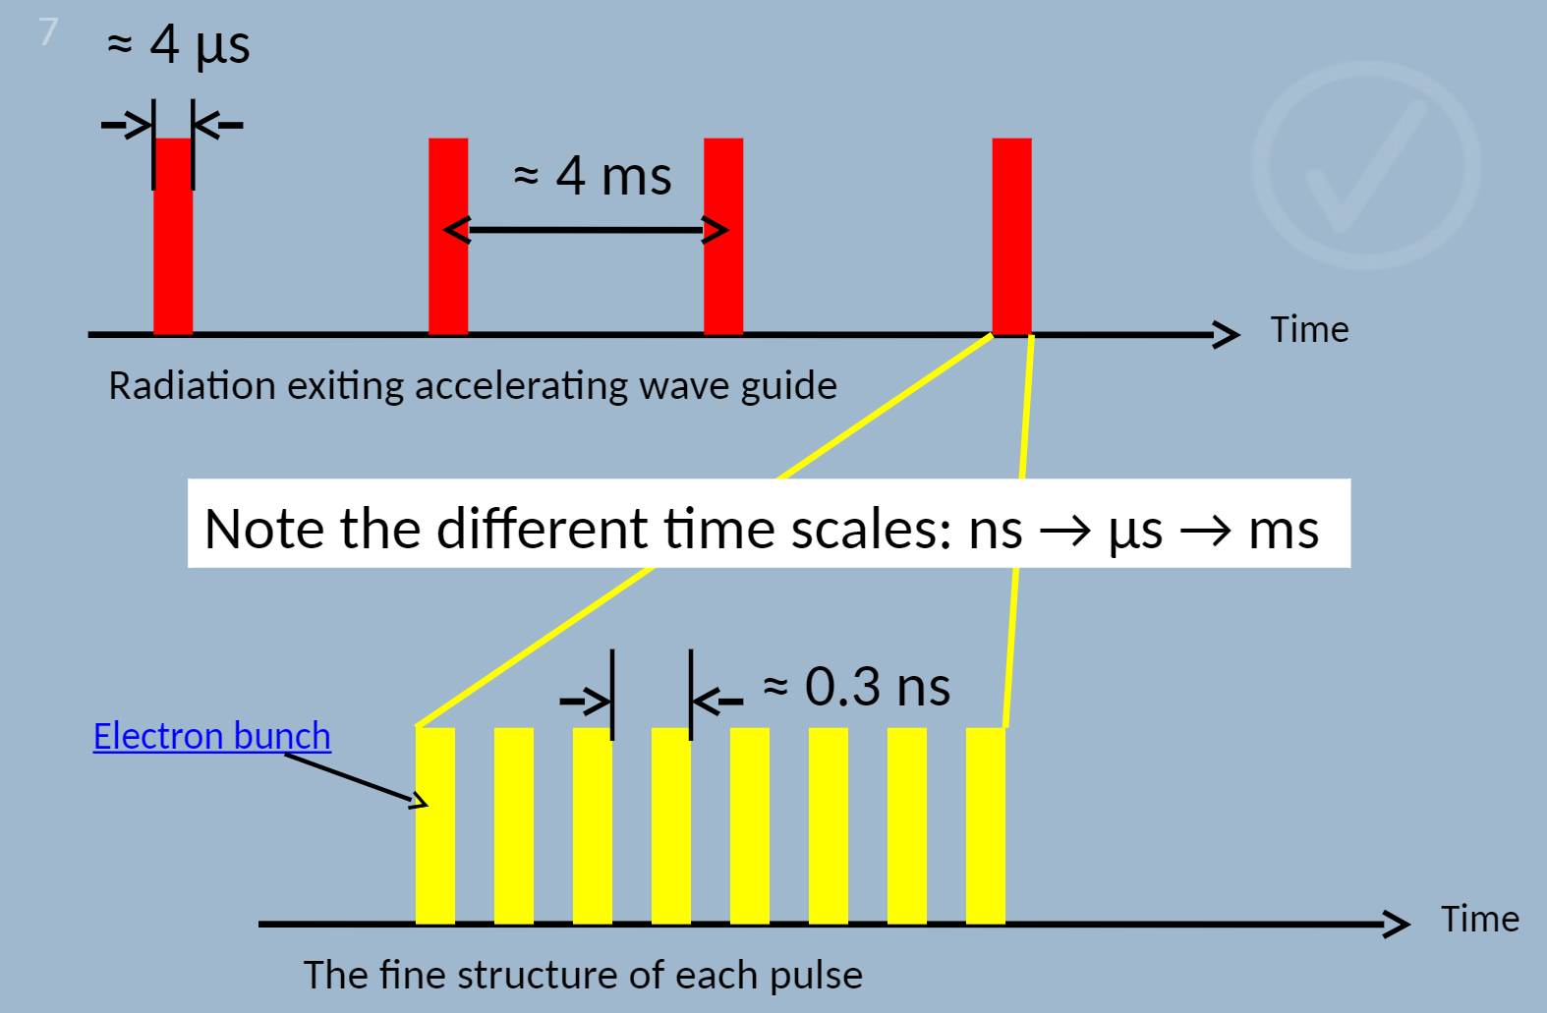
Answers 2
How long are these pulses?
What is the time in between pulses?
Duty cycle of ~0.1%

Slide 13
Question 3
If the thyratron in your linac breaks, what symptoms will the machine exhibit?
What QA is recommended after replacement of the thyratron?

Slide 14
Answers 3
If the thyratron in your linac breaks, what symptoms will the machine exhibit?
There will be no beam at all as the thyratron will essentially remain in the “off switch” mode
What QA is recommended after replacement of the thyratron?
No beam properties affected, as the thyratron is only a high voltage high speed switch. The actually voltage and pulse repetition rate is controlled by other components in the Pulse Modulator.
Therefore, after thyratron replacement, no QA is recommended

Slide 15
Modulator
Pulse Forming Network
Receives power from the De-Qing thyratron
Steps up voltage from 10kV to ~100kV
Pulses are sent to the RF driver, klystron/magnetron, and electron gun

Slide 16
RF Driver
Generates microwave frequency waves at 3000MHz
Operates at low power (100-300 peak watts)
Frequency of the RF driver is controlled precisely to match the resonant frequency of the main waveguide, which can vary with temperature due to expansion/contraction of the tube
Automatic Frequency Control (AFC) monitors this

Slide 17
Answers 4
Do all LINACs require an RF Driver?
No
LINACs with what component require one?
Only LINACs with klystrons require an RF Driver
LINACs with magnetrons do not require RF Drivers

Slide 18
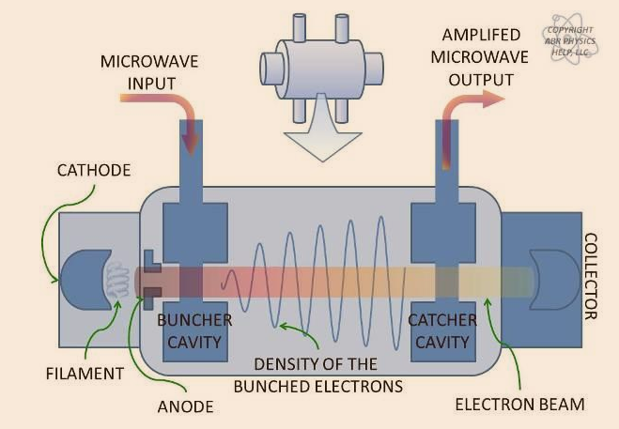
Klystron
Klystron is a microwave amplifier
Needs low power microwave source input to operate
RF driver provides this microwave input
Takes 100-300 Watt input from RF driver and steps it up to ~5-10MW
Operates like a mini-linac

Slide 19
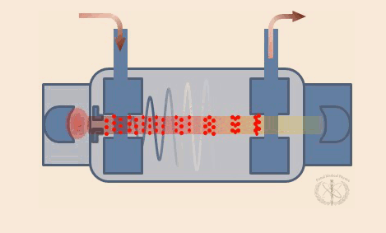
Klystron
Its own separate electron gun emits electrons which are injected into buncher cavity
Microwave input from RF driver is also sent into the buncher cavity
Electrons are bunched together as oscillating E-field of microwave input causes either an accelerating or retarding force on the electrons depending on when they enter the cavity
Lack of voltage difference between buncher and catcher (this region is called the drift tube) encourages the bunching effect
High power microwave output produced by passing electron bunches is extracted by the catcher cavity

Slide 20
Question 5
What is the alternative to klystron in high-power microwave generation?
What are the advantages of this device?
What are the disadvantages?

Slide 21
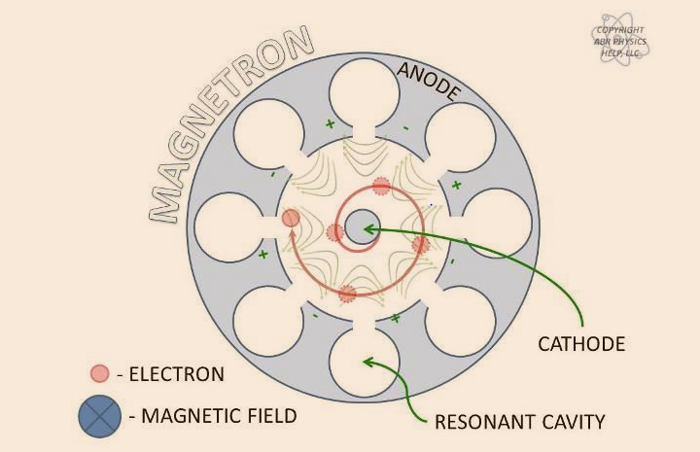
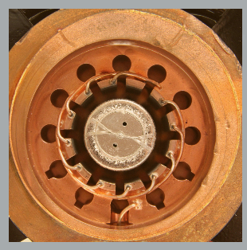
Magnetron
Can be used as a source of microwave power
Does not need an RF driver
Functions by boiling electrons off a central filament wrapped around a cathode
Electrons are then attracted to positively charged anode on outer edge of magnetron
In the presence of external magnetic field, these electrons take on a spiral trajectory
As the electrons pass the cavity openings, a resonance phenomenon is introduced
This leads to generation of microwaves at the resonant frequency

Slide 22
Question 5
What is the alternative to klystron in high-power microwave generation?
What are the advantages of this device?
What are the disadvantages?

Slide 23
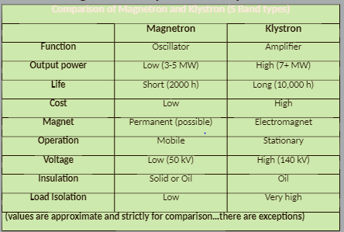
Answers 5
What is the alternative to klystron in high-power microwave generation?
Magnetron
What are the advantages of this device?
Microwave source
Smaller
Cheaper
What are the disadvantages?
Lower microwave output power
Shorter lifespan

Slide 24
Questions 6
What is the biggest limiting factor when considering designing a linac with a magnetron?
Which linacs use magnetron? Which use klystron?

Slide 25
Answers 6
What is the biggest limiting factor when considering designing a linac with a magnetron?
Reduced output power limits maximum achievable E of linac
Which linacs use magnetron? Which use klystron?
Tomotherapy, Cyberknife both use magnetron as they only deliver 6MV. Smaller size of magnetron advantageous for those designs.
Elekta also uses magnetron
Varian uses klystron

Slide 26
Circulator
One-way microwave valve
Prevents any reflected microwaves from returning to the klystron and RF driver, which would potentially damage them
Diverts reflected microwaves to a water load (for heat dissipation) or back to the accelerator waveguide so they aren’t wasted

Slide 27
Electron Gun

Slide 28
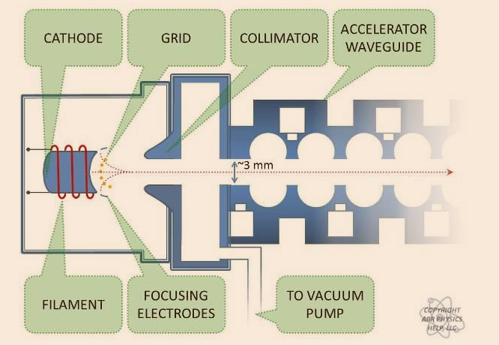
Electron Gun
In modern linacs, typical gun design is called a triode electron gun
Consists of cathode, anode, and electrified grid

Slide 29
Questions 7
What material is the filament of the electron gun?
What is the process called in which the electrons are generated from the filament?

Slide 30
Questions 7
What material is the filament of the electron gun?
Tungsten doped with barium oxide
Tungsten used for its high melting point (3422⁰C)
Barium used as it is a good donor of electrons that are easily boiled off
What is the process called in which the electrons are generated from the filament?
Thermionic emission → filament heated until electrons are boiled off

Slide 31
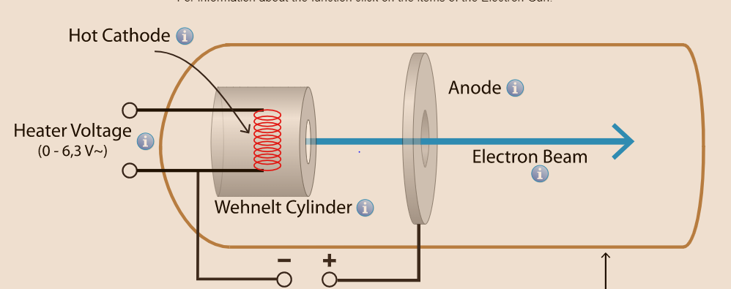
Electron Gun
Anode is usually doughnut shaped and given a positive charge to attract electrons toward it, which then pass through the hole
Electrons then enter the accelerating waveguide at 15kV

Slide 32
Questions 8
What is the purpose of the electrified grid?

Slide 33
Answers 8
What is the purpose of the electrified grid?
The grid controls when electrons are allowed to be injected into the accelerating waveguide and when they are electrically deflected away
This feature is used to control the dose rate of the linac by controlling the frequency of electron bunches being allowed to pass through

Slide 34
Accelerator Waveguide
Electron gun receives pulses from the modulator’s PFN in phase with the klystron output so electrons are injected into the waveguide with the proper timing for optimal acceleration

Slide 35
Questions 9
What are the two types of accelerating waveguide designs?
Which one do most modern linacs use? Why?

Slide 36
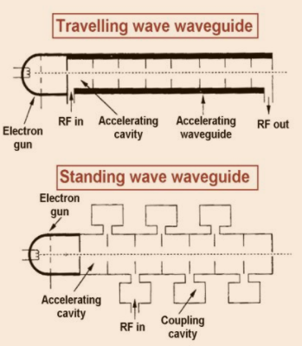
Accelerating Waveguide
Standing Waveguide – waves are reflected back and forth in the waveguide setting up a standing wave with high amplitude and resonance of ~3000MHz
Travelling waveguide sends microwaves down the accelerating waveguide and then either terminates the waves to a water load or recirculates them back to RF input
Standing waveguide are typically shorter in length due to constructive interference and side-coupled cavities, which move the nodes of the waves off to the side

Slide 37
Questions 9
What are the two types of accelerating waveguide designs?
Standing and travelling
Which one do most modern LINACs use? Why?
Standing waveguides → Shorter, more efficient accelerators, more stable

Slide 38
Accelerating Waveguide
Waveguide Video

Slide 39
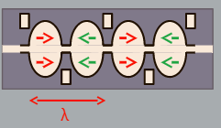
Standing Accelerating Waveguide
Each cavity length is ~½ wavelength
Most accelerating waveguides are operating in the S-band (3000MHz frequency)
Electrons are accelerated in each cavity. It goes through each cavity every half period.

Slide 40
Questions 10
Are all cavity lengths actually the same?
How could you design a smaller waveguide?

Slide 41
Answers 10
Are all cavity lengths actually the same?
No, diameter of each cavity is the same to keep the resonance properties matched. But the earlier cavities are shorter in length as electrons are being accelerated thus gaining speed and changing the amount of time it takes to traverse a cavity
How could you design a smaller waveguide?
Use a higher frequency (i.e. X-band = 9000MHz)
The challenge is that it is harder to keep the waveguide stable at higher frequencies

Slide 42
Accelerating Waveguide
The RF waveguide is filled with sulfur hexafluoride (SF₆), a dielectric gas which allows higher power transmission through the waveguide without breakdown (arcing)
Accelerating waveguide is held in vacuum
Accelerating waveguide is also equipped with a solenoid coil running the length of it to keep electrons focused in a pencil beam
Electrons naturally repel each other
Beam steering coils are used to inject the beam into the bending magnet at the proper location so that they eventually strike the target or scattering foils in the proper location

Slide 43
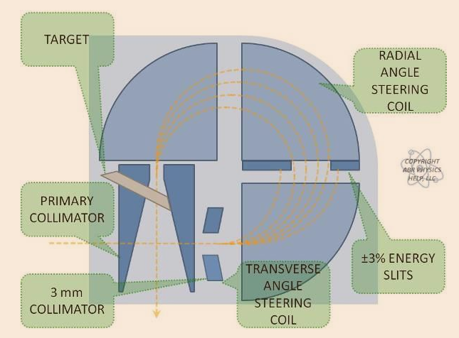
Bending Magnet
Two main purposes:
Takes beam travelling parallel to a patient and redirects towards them
Provides energy discrimination independent of the accelerating waveguide

Slide 44
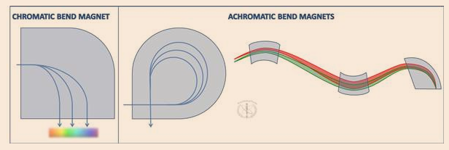
Bending Magnet
Two varieties of bending magnet: Chromatic and Achromatic
Chromatic bend magnet uses a 90⁰ bend. Disadvantage is that electrons emerge with different orientations depending on insertion angle, position, and energy
Achromatic designs utilize either a 270⁰ bend (most common) or a slalom 120⁰ bend to refocus the beam towards the target. Energy slit also helps with energy discrimination.

Slide 45
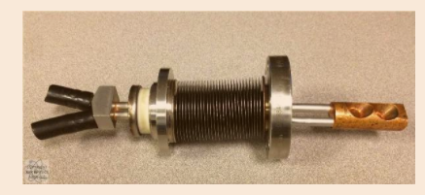
Questions 11 – Target
What is the target made of? Why?
What is the main interaction that produces x-rays from the target?
What is the efficiency of this x-ray production?

Slide 46
Answers 11 – Target
What is the target made of? Why?
Tungsten → again mostly due to its high melting point
Not as much due to the fact that it is high-Z
What is the main interaction that produces x-rays from the target?
Bremsstrahlung production
What is the efficiency of this x-ray production?
~20% efficient

Slide 47
Questions 12 –Target
What energy do the Bremsstrahlung photons have? Max? Average?
What is the implication of having a 20% efficiency?

Slide 48
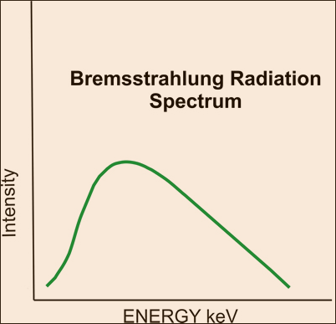
Answers 12 –Target
What energy do the Bremsstrahlung photons have? Max? Average?
Max energy of the incident E
Average energy of ~1/3 of the incident electron E
What is the implication of having a 20% efficiency?
Need a much higher electron current for photon delivery in order to maintain the same dose rate

Slide 49
Target
Target thickness affects….
Beam output → thicker target = higher attenuation
Beam spectrum → through beam hardening
Lateral beam spread
Low energy X-rays have a different target thickness than high energy X-rays to optimize the target efficiency for each beam

Slide 50
Primary Collimator
Round diverging collimator used to initially define the useful beam
Made of high attenuating material
What effect does the round design of the primary collimator have?

Slide 51
Primary Collimator
Round diverging collimator used to initially define the useful beam
Made of high attenuating material
What effect does the round design of the primary collimator have?
At largest field sizes (40x40cm²), corners of the field size are clipped and have sharper than expected falloff

Slide 52
Questions 13
What comes first, the flattening filter or monitor chamber? Why?
What is the purpose of the flattening filter? Why is it necessary?
What is the purpose of scattering foils? Why are there two?

Slide 53
Answers 13
What comes first, the flattening filter/scattering foils or monitor chamber? Why?
Flattening filter/scattering foils must be first. Not only does the monitor chamber measure output, but it also measures beam flatness and symmetry
What is the purpose of the flattening filter? Why is it necessary?
Flattening filter’s purpose is to reduce the beam fluence centrally to create a flat beam profile at a specific depth (usually 10cm)
It is necessary because the bremsstrahlung photons created from the target are pre-dominantly forward scattered, therefore the profile before the flattening filter is peaked centrally (like an FFF beam)
What is the purpose of scattering foils? Why are there two?
Scattering foils primary function is to scatter the electron beam to a clinically useful field size
There are often 2 layers of scattering foils, the first layer for scattering and the second layer for flattening

Slide 54
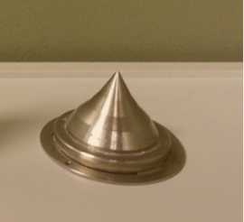
Flattening Filter
Cone-shaped to reduce beam fluence at center
Typically made of a medium-to-low Z material (aluminum)
Do not want high Z material as that will significantly harden the beam
Creates flat beam profile at specific depth (10cm)
Different flattening filters are needed for each energy
Downside of flattening filters is that they further reduce photon fluence

Slide 55
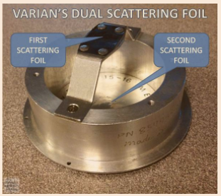
Scattering Foils
Converts thin pencil beam to a spread out electron beam
Made of lead or copper
Second foil is used to improve homogeneity across large field sizes
First foil – scatters
Second foil – flattens

Slide 56
Monitor Chambers
Two layers of chambers (MU1 and MU2)
Second layer is redundancy check in case first one fails
In each layer, 4 independent chambers are placed in each quadrant
These are used to monitor output, flatness, and symmetry of the beam
These chambers are sealed and pressurized so environmental variations have no impact on machine output
ION1 and ION2 are separate components which deliver test charge to the MU1 and MU2 chambers before clinical beam is delivered. This test charge is used to confirm their calibration
When you change output, you are changing MU1 and MU2 by telling these chambers how much collected charge is equivalent to 1 monitor unit (based on TG-51).

Slide 57
Remaining Beam Shaping Components
Jaws (Secondary Collimators)
Max transmission through these collimators must be <2% (defined by the IEC)
Clinically, transmission is typically <0.5%
Higher the jaw position, larger the penumbra
MLCs
MLC transmission should be less than 5% (Intraleaf leakage → usually <1%)
Interleaf leakage (between two leaves) should be approximately 1-2%
Blocks
Designed to have transmission of no more than 5%
Made of cerroband
Electron cones
Extend out from linac head to collimate beam closer to patient to minimize air gap, as electrons susceptible to scattering
Wedges

Slide 58
Energy Selection
Three possible options
Change electron beam current (called “beam loading”)
The more electrons we inject into the waveguide, the less energy each one will gain from microwave input. For a fixed microwave power input, increase in electrons leads to decrease in final energy
This technique is not used frequenty
Change the RF output power
Reduce RF power leaving the klystron, which will leave less energy to accelerate the electrons in the accelerating waveguide or vice versa
This can be done by changing the RF Driver input power to the klystron or changing the klystron amplification power
Short out part of the accelerating waveguide
Depending on the energy needed, a certain amount of the guide is shorted out so no acceleration occurs in those cavities
Using this technique is also called applying a plunger to the waveguide

Slide 59
Energy Selection
Change electron beam current (called “beam loading”)
This technique is not used frequently
Change the RF output power
This technique is commonly used but there is a limited range of energies available for a fixed waveguide length
Short out part of the accelerating waveguide
This is another common method

Slide 60
Energy Selection – Varian Machines
Disclaimer – I have seen conflicting information on how Varian machines operate 6e, 9e, 12e, 16e. Some sources say they operate in full waveguide mode, some say they operate in shorted mode
This info is consistent:
There are two waveguide modes: High energy and low energy
High energy mode utilizes the entire length of the waveguide
Low energy mode shorts out part of the waveguide with a copper pin
For 18X/20MeV → High energy mode is used
For 6X → Low energy mode is used
The klystron is fixed at a constant amplification power
The RF driver input power is varied to the klystron for smaller energy changes (i.e. 6e→9e)

Slide 61
Energy Selection – Varian Machines
One more consideration about why plunger is definitely needed for 6X:
Beam current required for 6X more significant than any other energy (lowest Bremsstrahlung efficiency and low output due to flattening filter)
Higher current → less stability as well, so shorter waveguide may help with this

Slide 62
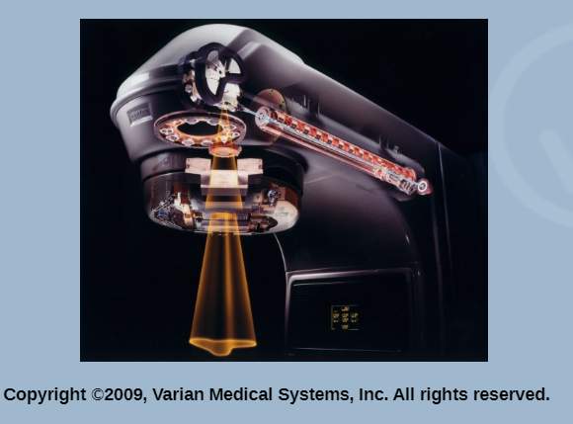
Changing Dose Rate – Varian Machines
Varian LINACs have a fixed pulse rate
This means the rate at which the accelerating cavity is energized is fixed. The microwave pulses will always be sent in every 4 milliseconds.
Dose rate modulation is controlled by the electrified grid of the triode electron gun
The grid determines which pulses receive electron-loading and which do not

